Slide 1
How We Manage Large-Scale Data Collection
Darryl Chamberlain, Ph.D.
Emily Faulconer, Ph.D.
Embry-Riddle Aeronautical University

Slide 2

As a mixed-method study, we are collecting a variety of data across 18 terms.
All data is collected in each term of MATH 111 and PHYS 102 between August 2021 and September 2023.
Withdrawals in MATH 111 and PHYS 102
Responses to voluntary, 8 Likert scale question survey
Student performance data (discussion grades and final grade)
Transcripts of discussion responses
Focus-group interviews
For context, PHYS 102 AUG ‘21 had 182 students and 39,682 sentences in discussion responses.

Slide 3
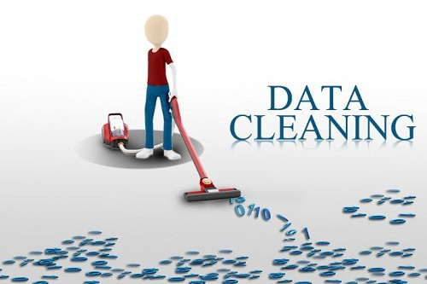
Data cleaning involves standardizing data for analysis and removing incomplete, irrelevant, or erroneous data.
For our data, this primarily included:
Standardizing withdrawal/drop reports
Downloading discussion transcripts and parsing them by sentence for analysis
Organizing all data for cross-semester analysis

Slide 4


Initially, we manually collected and cleaned discussion transcripts.
Create Word Document and list each instructor/student in the course.
Manually copy each response the instructor/student makes and organize in Word.
Replace names with IDs.
Copy/paste each sentence into an Excel sheet.

Slide 5
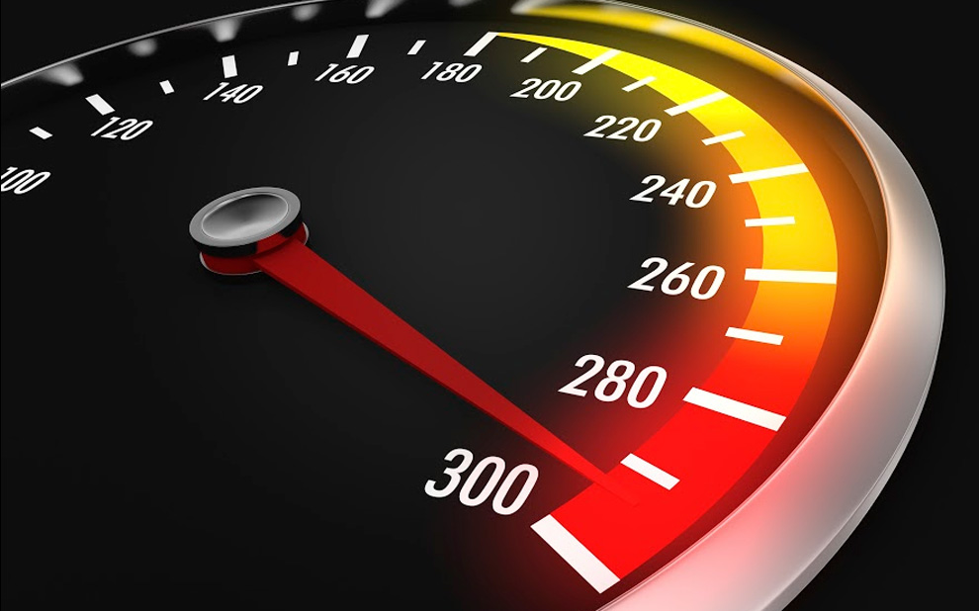
Now, we let technology do the heavy lifting.
Save the webpage as a PDF file.
Use an Adobe plugin to convert from a PDF to a Word file.
Run Python scripts on Word file.
Add results to master Excel file

Slide 6

A simple trick to improve your data organization is to put all data into columns.

Slide 7






















Common calculations such as AVERAGE, STDEV, and COUNTIF are far easier to complete when you can call an entire column.

Slide 8
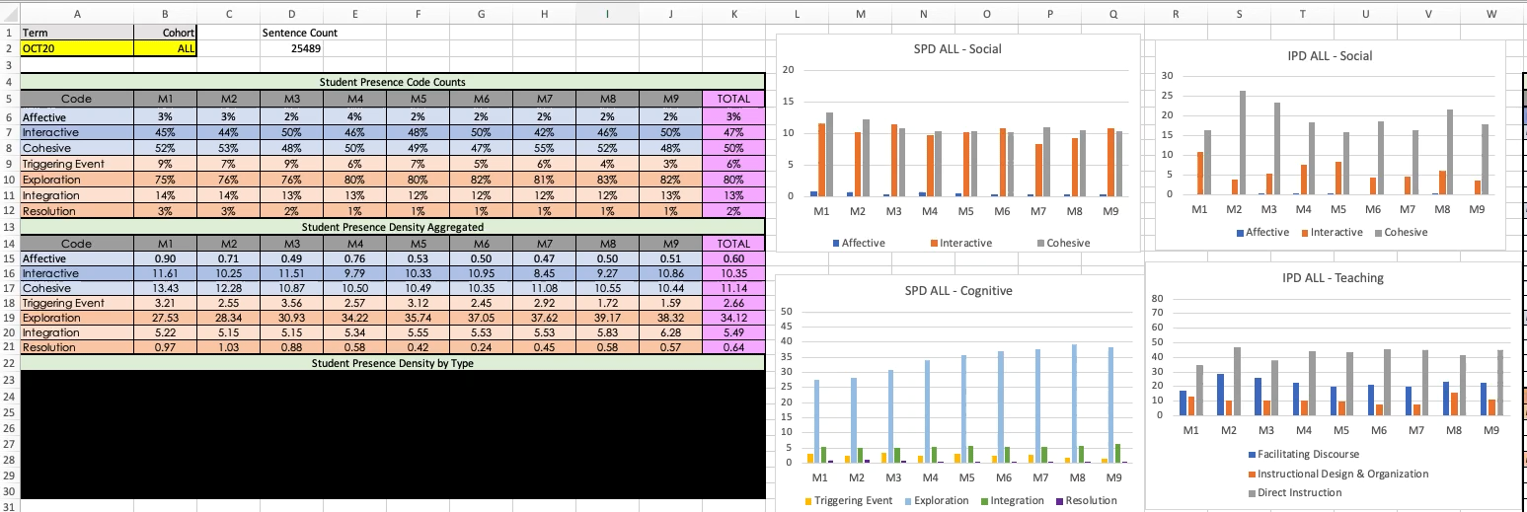
Strong data organization can allow seamless data analysis.

Slide 9
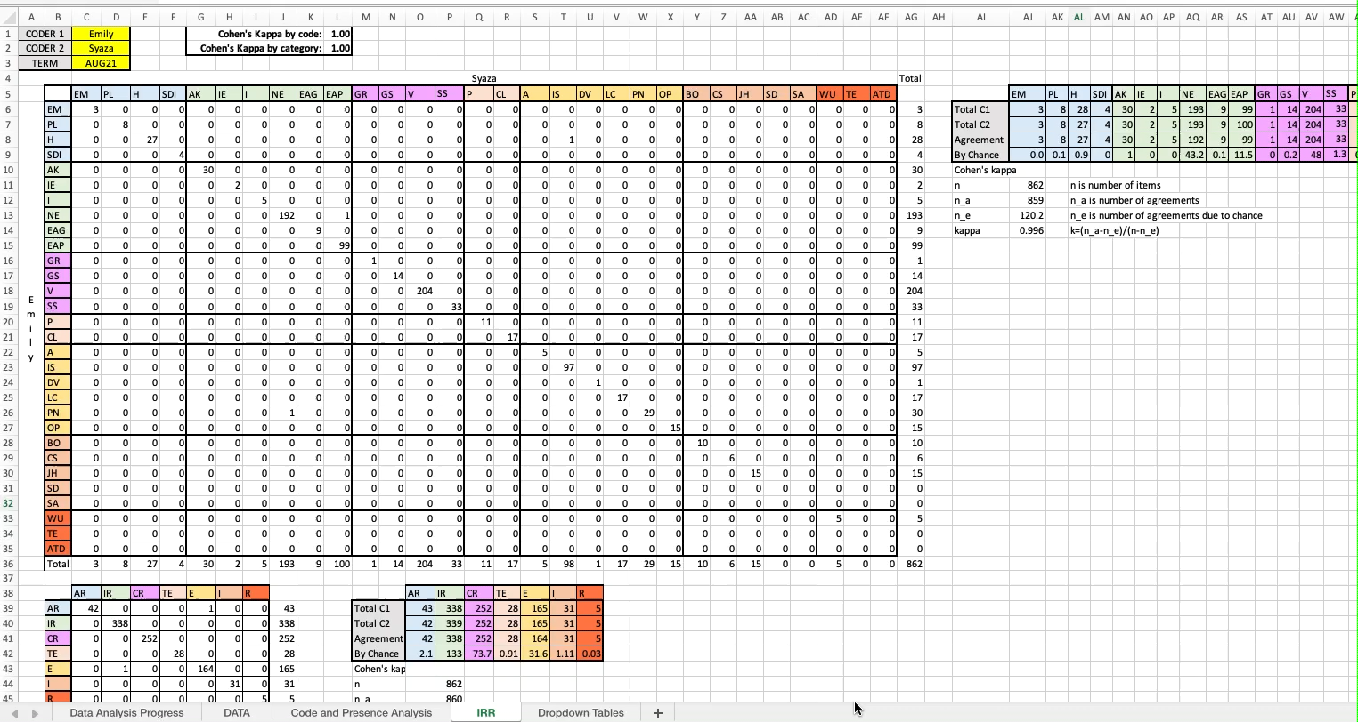
Data cleaning has a direct impact on data analysis.

